Slide 1

Research Methods & Ethics (URM 321)
Lecture 1
Introduction to Research Methodology
Prepared by:
Dr. Ahmed Abdelhafeez

Slide 2
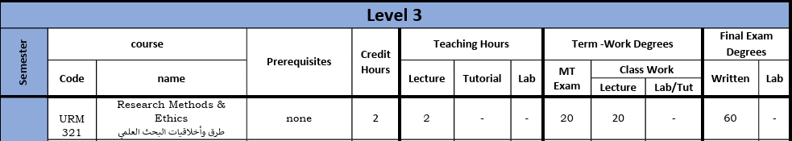
Course Details
Course details
Course details
Course details
Research Methods & Ethics
URM 321
2 Credit Hours
www.midocean.ae

Slide 3
Information about the course
This course offers an overview of essential concepts in research design, data collection, statistical analysis, result interpretation, and the preparation of final reports.
Students will concentrate on the steps required for designing a research project or research paper , with the course providing practical learning experiences in real-world scenarios.
The course emphasizes the skills necessary for scientific writing and the presentation of both oral and written data, as well as research findings.

Slide 4
Outlines
Overview
Research
Research Questions
Research Questions Characteristics
Computer Science Research
Research Methods
Attributes of Good Research Study
Characteristics of Research
Types Of Research Studies
Research Methods and Methodology

Slide 5

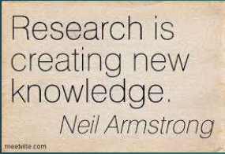

Overview
Overview
Research allows me to ask questions and formulate ways to answer them.
www.midocean.ae

Slide 6
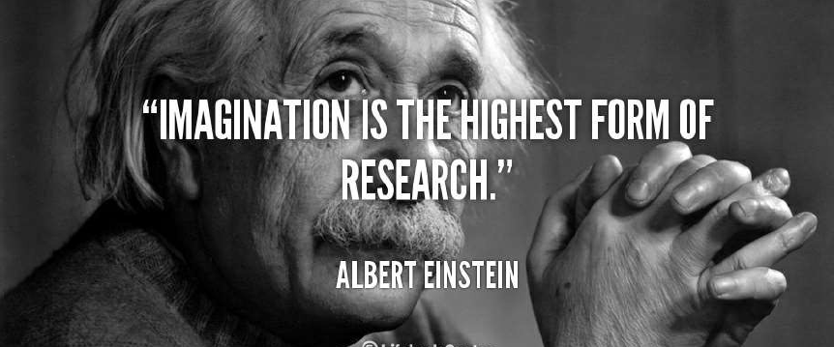
Overview (cont.)
Research is to see what everybody else has seen, and to think what nobody else has thought
www.midocean.ae

Slide 7

Where to Start From?
1. Decide on a general area of interest
Why does this area interest you?
2. Answer the questions:
What is the aim?
What is the hypothesis?
Does my work have novelty?
Why does it matter?
3. Discuss your ideas with others
Supervisors.
Co-Supervisors.
Close Colleague working in your domain.
4. Other issues to consider
Collaboration with Senior Researchers.
Get your research proposal peer reviewed at every stage from your Supervisor/Co-Supervisor.
www.midocean.ae

Slide 8

What is research?
Research is an art of scientific investigation.
Research is “Search of knowledge”- It is a scientific and systematic search for relevant information on specific topic.
Research is an organized set of activities to study and develop a model of procedure technique to find the result of a realistic problem supported by literature and data.

Slide 9

Research Questions
How can machine learning algorithms improve the accuracy of natural language processing tasks?"
"What are the security vulnerabilities associated with Internet of Things (IoT) devices, and how can they be mitigated?"
"What factors influence the adoption of new technology in healthcare settings?
A research question is a clear, concise, and specific inquiry that a researcher seeks to answer through their research study or investigation.
These questions are designed to guide the research process and help focus the study on a particular topic or issue.
Research questions typically address what the researcher wants to explore, understand, or investigate within their study.
Research Questions example
How can machine learning algorithms improve the accuracy of natural language processing tasks?
What are the security vulnerabilities associated with Internet of Things (IoT) devices, and how can they be mitigated?
What factors influence the adoption of new technology in healthcare settings?
www.midocean.ae

Slide 10
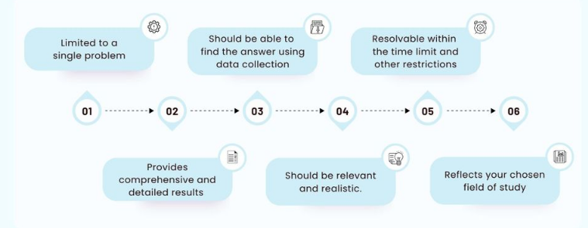
Research Questions Characteristics
www.midocean.ae

Slide 11

What is Computer Science Research?
Computer Science is a systematic study of computing systems and computation. The body of knowledge resulting from this discipline contains theories for understanding:
computing systems and methods;
design methodology,
algorithms, and tools;
methods for the testing of concepts;
methods of analysis and verification;
knowledge representation and implementation.
www.midocean.ae

Slide 12
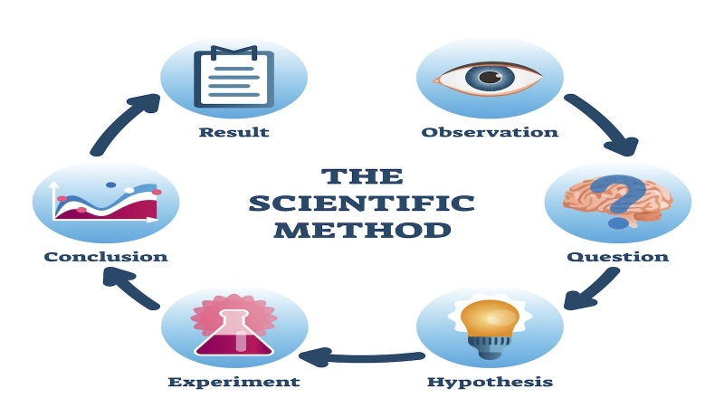
The Scientific Method
Share your findings
Conduct research
Examine your results
Make an observation
Ask the question
Draw a conclusion
Develop your hypothesis
Test your hypothesis with an experiment
www.midocean.ae

Slide 13
Research Methods
Research involves inductive and deductive methods:
Inductive methods analyzes the observation of phenomenon and identify the underlying principles, structures, or processes.
Deductive methods verify the assumed principles through observations.
The purposes are different: one is to develop explanations, and the other is to test the validity of the explanations. i.e., Validation of Simulation work with Experimental work
www.midocean.ae

Slide 14
Objectives of Research
The purpose of research is to discover answers through the application of scientific procedures.
The objectives are:
To achieve new insights into it- Formulative Research.
To portray accurately the characteristics of a particular individual, situation or a group -Descriptive Research.
To determine the frequency with which something occurs or with which it is associated with something else- Diagnostic Research.
To test a hypothesis of a causal relationship between variables -Hypothesis-Testing Research.
www.midocean.ae

Slide 15
Attributes of Good Research Study
Attributes of Good Research Study
OBJECTIVE: A good research must answer the research question.
CONTROL: A good research must be able to control all variables.
GENERALISABILITY: Generate similar result when used other method.
BIAS FREE: Research should be free from personal bias. It should be based on objective and not on subjective matter.
SYSTEMATIC: A good research study must have various well-planned steps, i.e. all steps must be interrelated, and one step should lead to another step.
www.midocean.ae

Slide 16
Criteria of A Good Research
1. Purpose clearly defined.
2. Research process detailed.
3. Research design thoroughly planned.
4. High ethical standards applied.
5. Limitations frankly revealed.
6. Suitable analysis for decision maker’s needs.
7. Findings presented unambiguously.
8. Conclusions justified.
9. Researcher’s experience reflected.
www.midocean.ae

Slide 17
Types Of Research Studies
Descriptive research: includes surveys and fact-finding enquiries of different kinds. It uses descriptive studies in which researcher seeks to measure characteristics like, shopping behavior, preferences, etc. Generally, survey methods are used for descriptive research.
Analytical research: includes use of facts and information already available and analyze these to make a critical evaluation of the material.
Applied research aims at finding a solution for an immediate problem facing a society or business organization. Marketing research, trend analysis are examples of applied research.
Fundamental research is concerned with generalizations and with the formulation of the theory. Research concerning some natural phenomenon or relating to pure mathematics are examples of fundamental research.
www.midocean.ae

Slide 18
Types Of Research Studies (cont.)
Quantitative research is based on the measurement of quantity or amount. It is applicable to phenomena that can be expressed in terms of quantity. For example, questionnaire survey result.
Qualitative research is concerned with qualitative phenomenon like relating to or involving the reasons or motives for human behavior. For example, word association, tests, sentence completion tests, story completion, etc.
Conceptual research is that related to some abstract ideas or theory. It is generally used by philosophers and thinkers to develop new concepts or to reinterpret the existing one.
Empirical research relies on experience or observation, often with some data-based research. It is necessary to get all facts and information at first hand.
www.midocean.ae

Slide 19
Research Methods and Methodology
Research Methods
Research Methodology
Research methods may be understood as all those methods/techniques that are used for conduction of research. It refers to the methods the researcher uses in performing research operations. Research methods can be put into following three groups:
Concerned with data collection
Concerned with statistical Techniques
Concerned with methods of evaluating the accuracy of the results obtained.
Research Methodology is a way to systematically solve the research problem.
It may be understood as a science of studying how research is done scientifically. When we talk of research methodology, we do not only talk of the research methods but also the logic behind the methods we use in the context of our research. Research Methodology has many dimensions and research methods do constitute a part of it.
www.midocean.ae

Slide 20



